Slide 1

EMAIL PLATFORM MIGRATION
Program Status Update
Prepared by Justin Rivera
Senior IT Systems Administrator
Review date: February 28, 2026

Slide 2
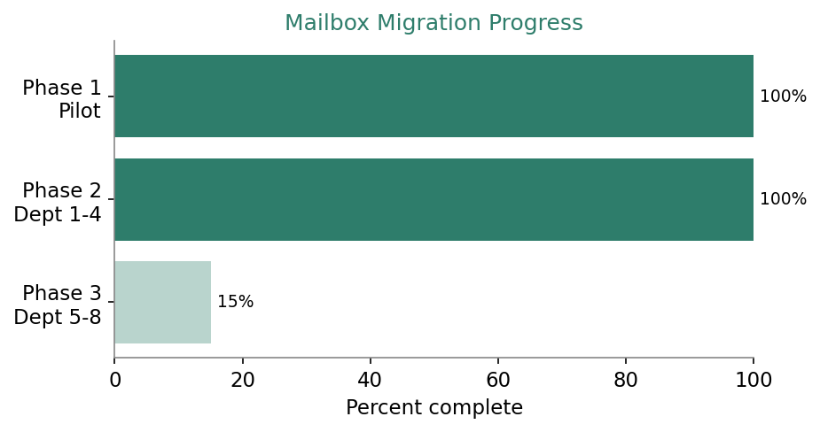
EXECUTIVE SUMMARY
Phase 2 complete, Phase 3 scoped
• On-premises mail is moving to a cloud tenant in three phases.
• Phases 1 and 2 delivered on schedule with no major incidents.
• Phase 3 covers the remaining departments, pending legal sign-off.
• Target completion ahead of the November security audit.
• Two mailboxes in Phase 2 required manual archive export.
Email Platform Migration | Status Update

Slide 3
PHASE STATUS
Where each phase stands
Phase | Scope | Mailboxes | Window | Status
1 - Pilot | IT and HR | 40 | Nov 2025 | Complete
2 - Wave A | Departments 1 to 4 | 320 | Feb 2026 | Complete
3 - Wave B | Departments 5 to 8 | 440 | Oct 2026 | Scoped
Phase 3 is gated on retention-policy confirmation from Legal and an approved MX cutover window.
Email Platform Migration | Status Update

Slide 4
RISKS AND NEXT STEPS
Closing out the program
Item | Owner | Action
Shared mailbox delegation | Priya | Test distribution-list workaround
Executive transport rules | Kyle | Document and recreate in tenant
MX record cutover | Tomas | Draft change request for approval
Retention policy scope | Justin | Escalate to Legal for confirmation
Email Platform Migration | Status Update

